Slide 1



Introduction
Contact Information:
Jeremy Schmerling
Jeremy@McKinleyinc.com
703-836-4445
www.mckinleymarketingpartners.com

Slide 2
Today’s Agenda
McKinley Marketing Partners overview
Applying for positions
Interview process
Marketing hiring trends
Q&A

Slide 3
WHO WE ARE
Since 1995 the McKinley team has been filling contract, contract-to-hire, and direct hire positions at commercial and nonprofit organizations of all sizes, across a variety of industries. Our candidates are skilled in traditional and digital marketing, writing, content creation, graphic design and web development. And, their passion and experience enable them to deliver results quickly.

Slide 4
WHERE WE WORK
McKinley Marketing Partners has offices in the Washington, DC area, New York, and Texas. Our corporate headquarters is located in Alexandria, VA.
NEW YORK CITY
WASHINGTON, D.C. AREA
DALLAS
HOUSTON

Slide 5
What to think about when
applying for a new job
Tailoring your resume
  Tell a story
  What to include on your resume
  How long is too long?
LinkedIn consistency
  Does it matter?

Slide 6
Interviewing
Phone Interviews
  Three ways to fail a phone interview
Skype Interviews
  Details matter – attire, environment, distractions, and eye contact
In-Person Interviews
  Come prepared
According to a Career Builder survey, hiring managers are 22% less likely to offer a job to a candidate who does not send a thank you note

Slide 7
Marketing Hiring Trends
Survey sample
  Surveyed 186 people in the marketing function or who have influence in selecting candidates for marketing position
Companies surveyed with:
  500 + employees = 55%
  100 – 499 employees = 19%
  1 – 99 employees = 26%

Slide 8
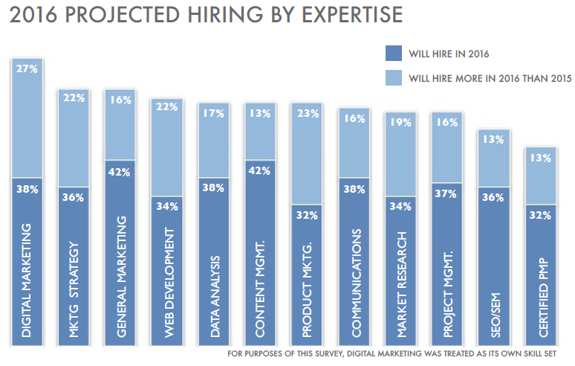

Slide 9
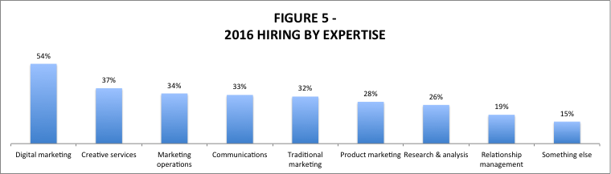
2016 Actual Hiring
As we anticipated going into 2016, digital marketers were in the highest demand.
Those on the creative side of marketing were second most in demand but far behind
digital marketers (figure 5 2016 HIRING 2).
Among those who hired for digital marketing, digital advertising, as well as content creation,
curation, and strategy were the most in demand digital marketing expertise areas.
Partner marketing, direct response, and project management were in least demand.

Slide 10
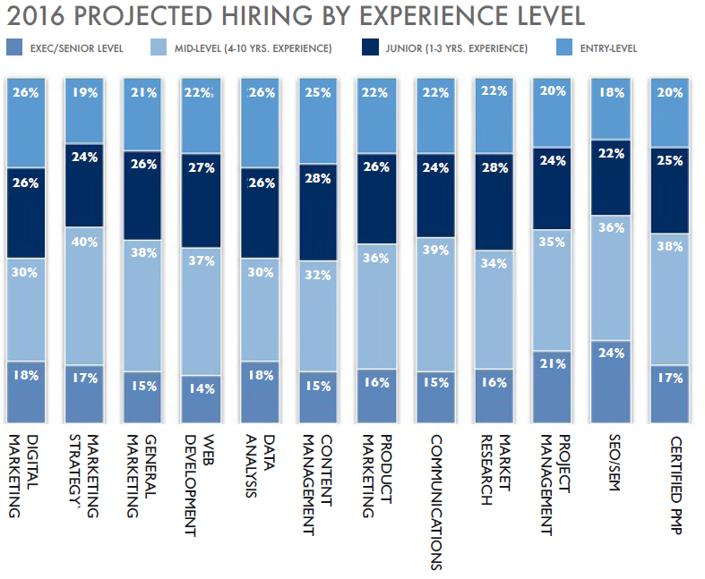

Slide 11
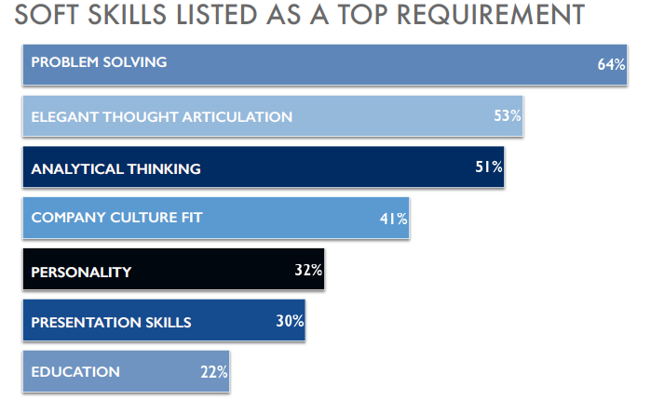

Slide 12
Marketing Expertise in Demand for 2017

Slide 13
Thank you for your time and let’s make the most of 2017!

