Slide 1
Experience as an Advantage
Being 40+ in the workforce
Employer Views
Techniques to address biases
R. Anne Hull, M.Ed

Slide 2
Today’s workforce demographics
Workforce
Impact
Multi-generational
Variety of expectations
Not retiring as planned
Stay in │competing for jobs
Skills automated or
outsourced
Must update skills
> 20 % of new businesses started by people 55-64.

Slide 3
Mature Job Seeker’s Search
What’s the Same
What’s Different
“Know thyself”
Value proposition
Resume/Cover letters
Targeting
Networking
Interviewing
Negotiating
Everything +
Emotions / Issues
Resources
Strategies
Notes:
What is the Job search process?

Slide 4
Age Bias
“Over Qualified”
“Under Qualified”
What are my biases?

Slide 5
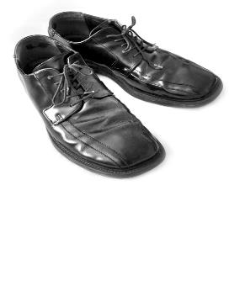
What Employers Fear
Health issues – absenteeism, costs, morale
Change averse
Technology luddite
Expiration date
Cannot work with younger boss
Won’t have Organization’s “look”
Won’t last if at lower $ or role
Notes:
Ageism in the workplace is illegal.
Ageism is alive and well and living among us.
The age question often comes down to concerns that you won’t stay in good health, or have the energy and desire to do the job the way a younger worker might.
There’s the underlying feeling that you are resistant to change and not up to speed with technology.
Then too, there’s the perception that you’re not in it for the long haul. Employers see your proverbial expiration date.
They might believe that you don’t want to work for someone younger than you are.
If you’re accepting a job at a lower salary, or not as lofty a position as you held in your last position, a hiring manager might conclude you will jump ship if a better offer comes your way. (Be honest, you might.)

Slide 6
What Employers Need
Experience translated into value
Engagement – Culture Fit / Care
Network
Critical Knowledge
Customer
Industry
Legal
Notes:
Critical knowledge walking out the door – valuable to competitor, start-up, different industry
By the time you get to the interview, already determined you have the technical skills through the screening processes.
Now the questions are:
Can you do the job HERE
Will you fit in with us? Aon 2014 Report Skills Business Case - A Look at the Value of Experience 2015
Highest engagement level

Slide 7
Benefits of being 40+
The long view – bigger picture
Workplace savvy
Communication skills
Able to deal with “crisis”
Efficiencies
Detail, focus, attentive
Dependable / punctual
Honesty
Ability to do/learn the job
Experienced
Seasoned
Notes:
What does an employer get from someone who is “experienced” Seasoned”? Professional?
Punctuality -look forward to going to work each day, arrive on time and be ready to work.
Honesty values include personal integrity and a devotion to the truth.
Detail-oriented, focused and attentive workers add an intangible value that rubs off on all employees - older workers finding others' potentially costly mistakes regarding everything from misspelling of client names to pricing errors and accounting mistakes.
Pride in a job well done Younger workers want to put in their time at work and leave, older employees a more willingl to stay later to get a job done because of their sense of pride in the final product.
Organizational skills 1M+ man hours are lost each year simply due to workplace disorganization.
Efficiency and the confidence to share their recommendations/ideas -understand how jobs can be done more efficiently, which saves companies money. Their confidence, built up through the years, means they won't hesitate to share their ideas with management.
Maturity /Example get less "rattled" when problems occur - makes training other employees less difficult.
Communication skills--knowing when/how to communicate-workplace politics and know how to diplomatically convey their ideas to the boss.
Reduced labor costs. Are willing to take a little less to get the job they want. They understand that working for a company can be about much more than just collecting a paycheck. Cash or Cachet?

Slide 8
Benefits of being 40+
"Many older people have a work ethic and sense of civility that the younger generation has not learned yet."
Steve Wing,
Director of Government Programs
CVS drugstore

Slide 9
Techniques to address biases
First, you cannot …
Compel employers to communicate
Challenge their authority
Challenge legitimate job requirements
http://www.aarp.org/work/employee-rights/info-05-2008/what_you_can_do_about_age_bias.2.html
Notes:
Norm: no acknowledgement other than an auto-reply message, long delays or no invitation to interview, no feedback following interviews, and no explanation or notice of rejection. Employers are often overwhelmed by the sheer volume of applicants and have little choice but to acknowledge resumes via auto-reply e-mail, if at all. Employers have become extremely cautious about what they say to candidates and to employees. Stop expecting promptness and responsiveness. 2. Managers and executives will generally make decisions about hiring and firing based on the organization’s financial condition. You may not agree, you may not like it, and there’s not much you can do other than file an age discrimination complaint or claim. This is not an action that will endear you to your employer, It may be uncomfortable, but it may be your only option. 3. You can’t challenge legitimate job requirements: Employers are permitted to establish bona fide (legitimate) job qualifications, and they can even refer to age. For example, An advertising agency can require that a model for teen clothing not be older than a given age. Employers are generally very careful about setting job qualifications—even though they may appear discriminatory. Work in a lab or clinic may require an ability to routinely lift up to 60#. There are cases when you can request a “reasonable accommodation” to permit you to perform the job, but this is generally the only way around job requirements. Sometimes it’s simply necessary to look for a different job.

Slide 10
Techniques to address biases
Believe in yourself
Take care of your health
Notes:
Get clear on your work objectives. Your clarity and confidence of purpose will come through to employers.
How do they know how old you are?
Anticipate and prepare for bias
Exercise and Take care of your health

Slide 11
Techniques to address biases
3. Reframe your experience
4. Prepare your stories
5. Look in the right places
Notes:
Look at your skill set and past experience as transferable to different challenges and fields. “What problems can you solve?” If you’re switching industries, you’re not reinventing yourself entirely. You’re redirecting skills you already have. Cast a wide net.
Reframe your experience. You’re selling how your deep knowledge-base and skills can solve business problems in the future regardless of the employer.
See if your work style is a good match for small-medium size companies who are much more likely to take on aging Boomers who bring a track record of accomplishment and who can clearly add value. Fewer employees mean all hands on deck need to bring their “A” game. You can provide the depth of practical knowledge and versatility that’s worth two junior hires, and the learning curve is not as steep.
Money can trump age. As an employee, you either make money or save money for your employer. If the hiring manager doesn’t see your value in one of these two categories, then you don’t want to work for this company. If the company isn’t concerned about its bottom line, then it may not be around for long, and isn’t a viable option for you anyway.
Seek employment and work in the right places: Many industries and employers value older workers. AARP Best Employers for Workers Over 50: A list of employers recognized by AARP for their exceptional practices relating to the older workforce. Web Job-Posting Boards for Older Workers:

Slide 12
Techniques to address biases
Techniques to address biases
85%
www.PeopleHirePeople.com
Notes:
85% of jobs are unadvertised Kathleen Conners Recruiter & Author www.PeopleHirePeople.com
candidate search to remain confidential. He felt he could not promote anyone on his team
did not have any open requisitions However he wanted to explore potential candidates when funding did come thru

Slide 13
Techniques to address biases
Get digital – online profiles │ participation
Get noticed for the right reasons
Get your network onboard
Find employee referrals
Meet the decision-maker first

Slide 14
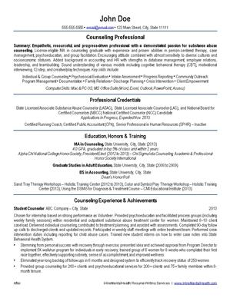
Techniques to address biases
Techniques to address biases
Resumes
Update vocabulary and punctuation
Show your social media fluency
Stick to relevant experience
Show results

Slide 15
Techniques to address biases
Techniques to address biases
Interviews
What do they really want to know?
Use recent examples
Energy and enthusiasm
Talk about results and future benefits for the employer
Notes:
Questions
Strategies to respond

Slide 16
Techniques to address biases
Techniques to address biases
Interviews
AVOID:
The “look”
A parental tone of voice
Dated phrases or milestones
Notes:
Been there, done that phrases

Slide 17
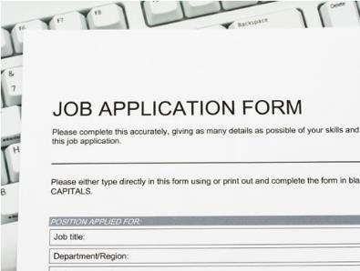
Techniques to address biases
Techniques to address biases
Job Applications
Screening mechanism
Success begins with a conversation
Notes:
“That’s how we hire here.” = crowd control and HR compliance screening – may start background checks from this data. Hiring manager never sees dates.
Let your ethics be your guide.
Choose an answer to get the conversation
Another perspective:
If the dropdown box for high school graduation doesn’t go back far enough – take a screen shot. If you don’t get the job this is evidence to file an EEO complaint.

Slide 18
Resources
Jobs, featured columns and more
http://www.workforce50.com
http://www.jobs4point0.com/
Age Friendly Companies http://www.simplyhired.com/a/special-searches/fifty-plus
http://www.aarp.org/work/employee-benefits/best_employers/
Good research site http://www.smartworkforcestrategies.com
Notes:
Workforce50.com arms the older workforce with employment resources and career information to achieve their goals. Help them make the most of their talents

Slide 19
Questions?
Discuss
Conversation
Wonder?
Comment
Reflect
Impact
Ask
Discover
Share
Explore
Curious?

